Slide 1
Data-Link Layer: Error Detection & Correction
Covers Chapter# 10 from Text Book
Computer Communication & Networks
(CEN-223)
Fall 2022 (BSE-5A)

Slide 2
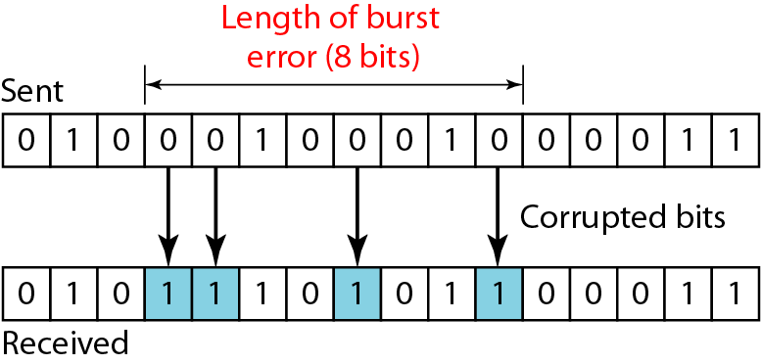
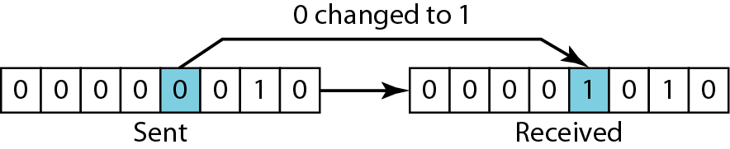
Types of Errors
Transmitted bits are subject to unpredictable changes, because of several factors including interference.
Single-bit error: means that only 1 bit of a given data unit is changed, either from 1 to 0 OR from 0 to 1.
Burst error: two or more bits in a given data unit have changed.
Single-bit error
Burst error

Slide 3
Redundancy and Coding Techniques
Redundancy: extra bits sent with the data for detecting or correcting errors.
Redundancy is added at the sender side and removed at the receiver side.
In general, the sender adds redundant bits through a process that creates a relation between redundant bits and actual data bits.
Redundancy is obtained using various coding schemes, where coding schemes can be divided into: Block coding and Convolutional coding.

Slide 4
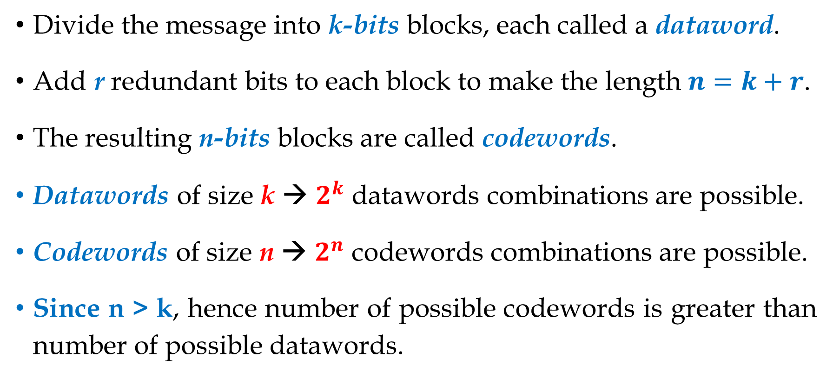
Block Coding
Hamming code is called a block code because information is blocked into bit sequences of finite length to which a number of redundant bits are added.
Divide the message into k-bits blocks, each called a dataword.
Add r redundant bits to each block to make the length $n=k+r$.
The resulting n-bits blocks are called codewords.
Datawords of size k → $2^{k}$ datawords combinations are possible.
Codewords of size n → $2^{n}$ codewords combinations are possible.
Since n > k, hence number of possible codewords is greater than number of possible datawords.

Slide 5
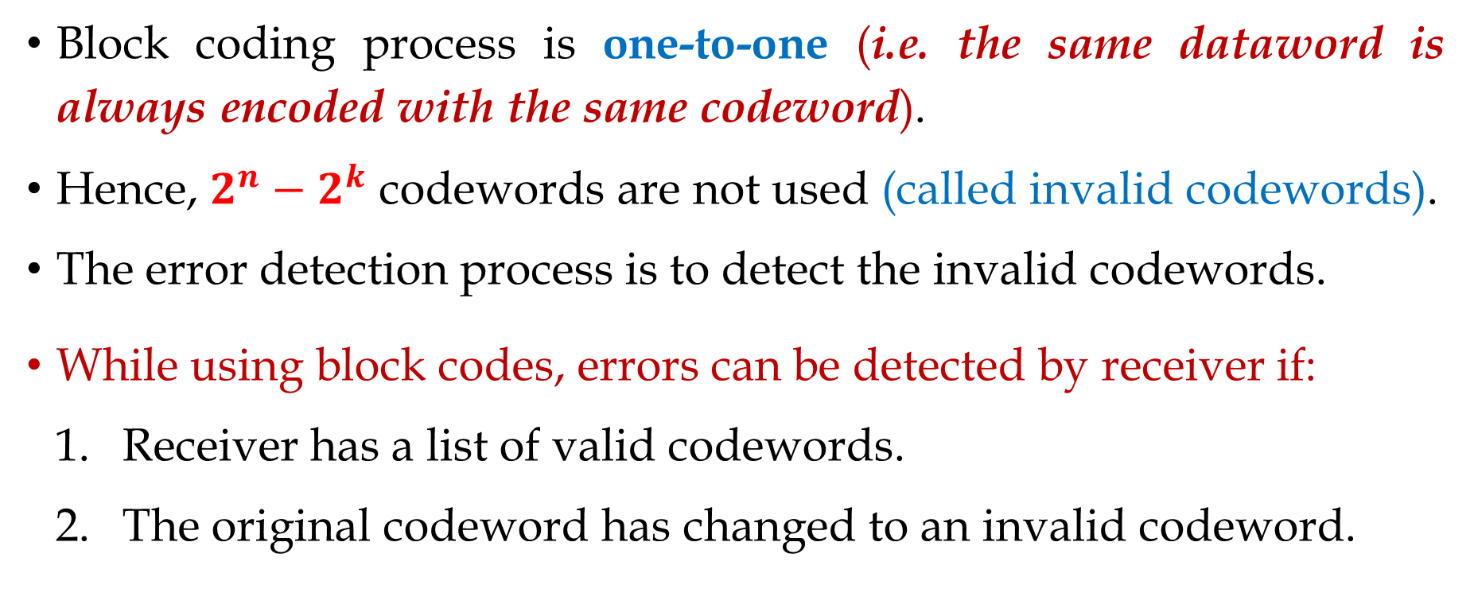
Block Coding (Cont.)
Block coding process is one-to-one (i.e. the same dataword is always encoded with the same codeword).
Hence, $2^{n}−2^{k}$ codewords are not used (called invalid codewords).
The error detection process is to detect the invalid codewords.
While using block codes, errors can be detected by receiver if:
Receiver has a list of valid codewords.
The original codeword has changed to an invalid codeword.

Slide 6
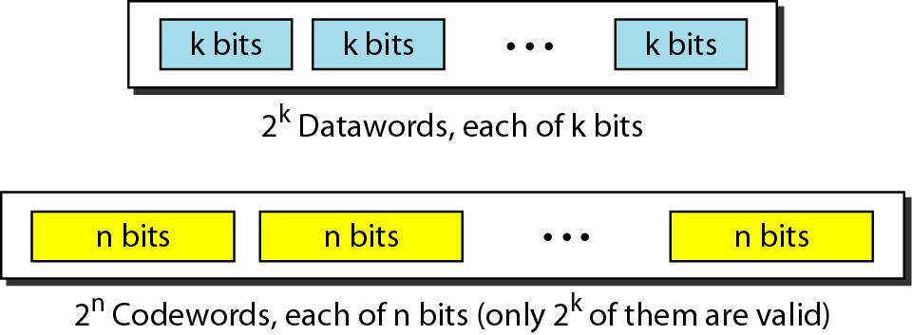
Block Coding (Cont.)
Example: A coding scheme in which k = 4 and n = 5. We will have 2^{k} = 16 datawords and 2^{n} = 32 codewords, where 16 out of 32 codewords are used for message transfer and the rest will be considered as invalid.

Slide 7
Error Detection in Block Coding
At the receiver side:
If received codeword is the same as one of the valid codewords, the codeword is accepted → corresponding dataword is extracted.
If received codeword is not valid, it is discarded.
If received codewrod is corrupted but still matches a valid codeword, the “error remains undetected”.
An error-detection code can detect only the types of errors for which it is designed; while other types of errors may remain undetected.

Slide 8
Error Detection in Block Coding (Cont.)
Example: assume k = 2 and n = 3. Table below shows the list of datawords and codewords.
100 & 010
111 & 001
001 & 111
010 & 100

Slide 9
Error Detection in Block Coding (Cont.)
Example: assume that sender encodes the dataword 01 as 011 and sends it to the receiver. Consider the following cases:
Receiver receives 011, i.e. a valid codeword. The receiver extracts the dataword 01 from it.
The codeword is corrupted and 111 is received, i.e. not a valid codeword. Hence, it is discarded.
Codeword is corrupted and 000 is received, i.e. a valid codeword. Hence, receiver incorrectly extracts dataword 00. Hence, two corrupted bits made error undetectable.

Slide 10
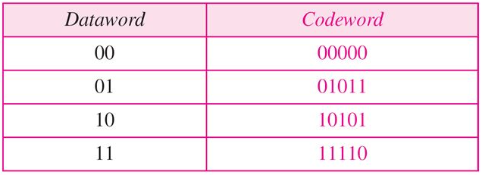

Slide 11
Assume the data word is 01.
The sender consults the table (or uses an algorithm) to create the code word 01011.
The code word is corrupted during transmission, and 01001 is received (error in the second bit from the right).
First, the receiver finds that the received code word is not in the table.
This means an error has occurred. (Detection must come before correction.)

Slide 12
1. Comparing the received code word with the first code word in the table (01001 versus 00000), the receiver decides that the first code word is not the one that was sent because there are two different bits.
2. By the same reasoning, the original code word cannot be the third or fourth one in the table.
3. The original code word must be the second one in the table because this is the only one that differs from the received code word by 1 bit. The receiver replaces 01001 with 01011 and consults the table to find the data word 01.

Slide 13
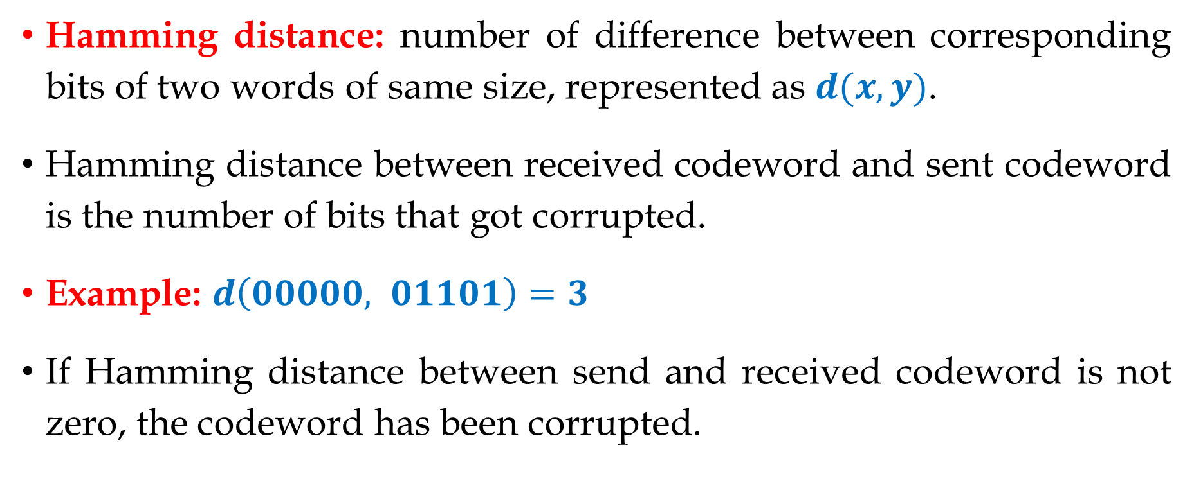
Hamming Distance
Richard W. Hamming.
Hamming distance: number of difference between corresponding bits of two words of same size, represented as $d(x,y)$.
Hamming distance between received codeword and sent codeword is the number of bits that got corrupted.
Example: $d\left(00000, 01101\right)=3$
If Hamming distance between send and received codeword is not zero, the codeword has been corrupted.

Slide 14
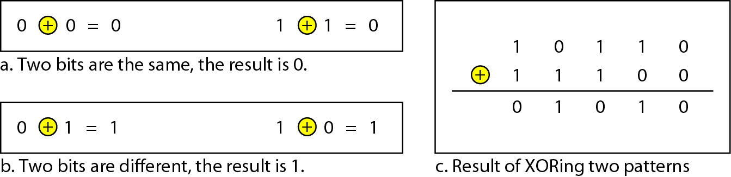
Hamming Distance (Cont.)
Apply XOR and count number of 1s.
Proper solution for programming in computers.

Slide 15
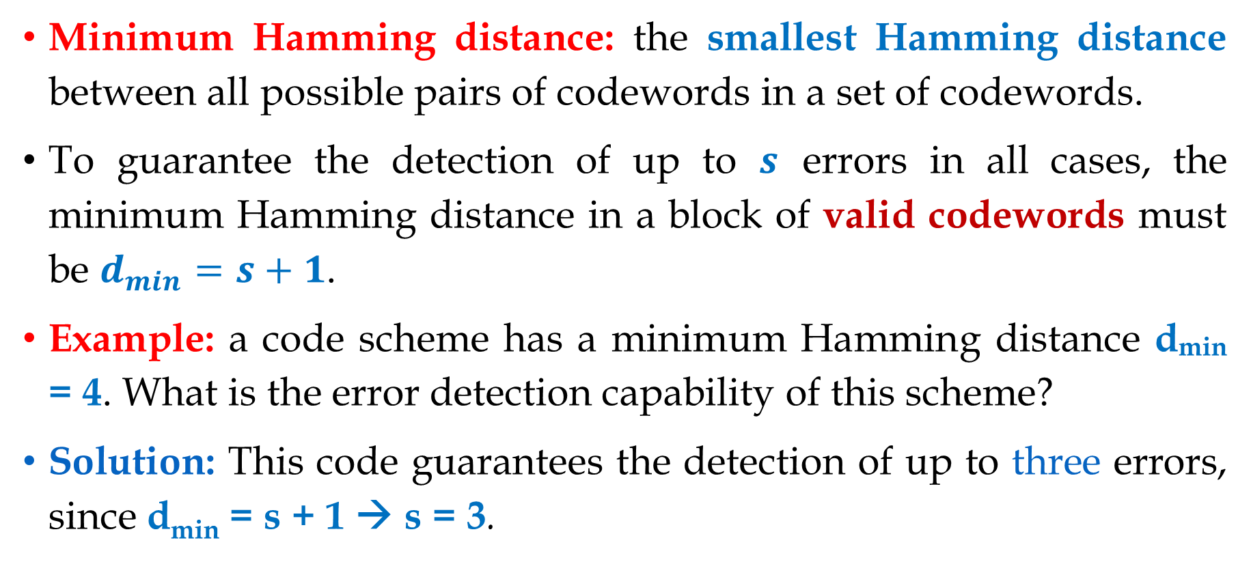
Minimum Hamming Distance
Minimum Hamming distance: the smallest Hamming distance between all possible pairs of codewords in a set of codewords.
To guarantee the detection of up to $s$ errors in all cases, the minimum Hamming distance in a block of valid codewords must be $d_{min}=s+1$.
Example: a code scheme has a minimum Hamming distance d_{min} = 4. What is the error detection capability of this scheme?
Solution: This code guarantees the detection of up to three errors, since d_{min} = s + 1 → s = 3.

Slide 16
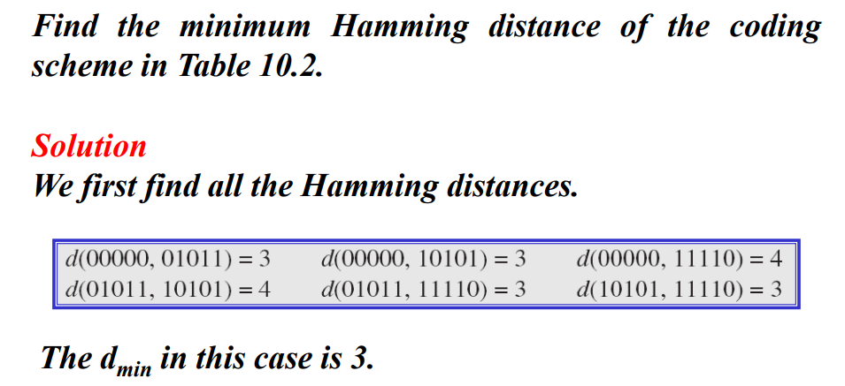

Slide 17
Before understanding the working and general algorithm of hamming code, it is vital to know specific essential terms related to the Hamming code example discussed in the article.
1. Error-correcting code: A code used in digital communications to detect and correct errors parallelly that occur during data transmission.
2. Redundant bits: The extra bits added to a message to enable error detection and correction. Hamming code uses redundancy to detect and correct errors in transmitted messages

Slide 18
3. Position of redundant bits: The redundant bits are assigned to positions that coincide with the power of 2. Ex, 2^p (where p=0,1,2,3…)
Redundant bits: r1, r2, r4
Data bits: d0, d1, d2, d3
4. Parity bit: An extra bit added to a message to check for errors. The number of 1s in the message finds the parity bit's value. Parity bits are of two types
Odd parity: Here, the count of 1's should be odd
Even Parity: Here, the count of 1's should be even

Slide 19
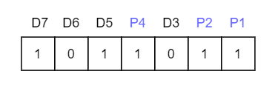
Let us understand the hamming code with example, we have to identify the bit position of the data and all the bit positions are the powers of 2 are marked as parity bits (e.g. 1, 2, 4, 8, etc.). Below the image you can easily visualizing the hamming code.
Even parity which ensures that the total number of 1's are even (even parity) or odd (odd parity).

Slide 20
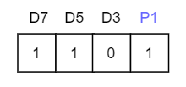
Step 1: Check the parity bit P1 by technique check one and skip one. We started from P1 and skip P2 and show on. This way we will have the following bits,
As we can observe the total number of bits is odd so we will write the value of the parity bit as P1 = 1. This means an error is there. Then we will write the value of P1 = 1
Even parity p = 0 (even number of 1s in data)

Slide 21
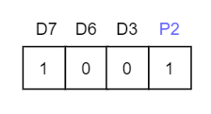
Step 2: Check for P2 but while checking for P2, we will use check two and skip two methods. Now start counting from P2, consider P2, D3, D6 and D7.
As we can observe that the number of 1's are even. This means there is no error. Then we will write the value of P2 = 0

Slide 22
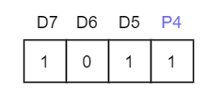
Step 3: Check for P4 but while checking for P4, we will use check four and skip four method, count from P4, D5, D6, D7 and P1 to P2 should not be considered.
As we can observe that the number of 1's is odd. This means the error is there. Then we will write the value of P4 = 1.
So, from the above parity analysis, P1 & P4 are not equal to 0, so we can clearly say that the received hamming code has errors.

Slide 23
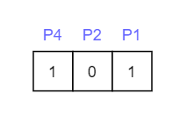
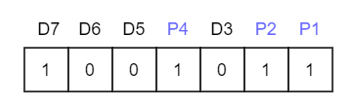
We revived a hamming code which has error in data. So, must correct them. We use these steps to correct hamming code.
Now the error word E will be:
hamming-code-Error-Correction-1
Now we have to determine the decimal value of 101 is 5.
We get E = 5, it means the error is in the fifth data bit. To correct it by invert the fifth data bit.
So the correct data will be:
Correct show with 0 and error show with 1

Slide 24
Linear Block Code
Liner block code: a code in which XOR of two valid codewords creates another valid codeword.
Example: (previous example of k = 2 and n = 3, table given below).
In linear block codes, minimum Hamming distance is the number of 1s in nonzero valid codewords having the smallest number of 1s.

Slide 25
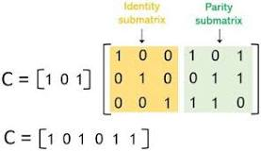

Slide 26
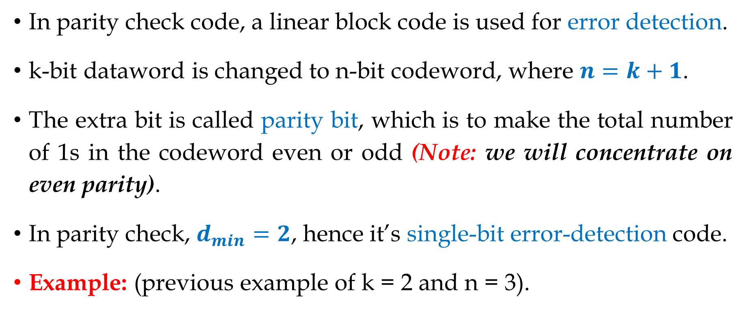
Parity Check Code
In parity check code, a linear block code is used for error detection.
k-bit dataword is changed to n-bit codeword, where $n=k+1$.
The extra bit is called parity bit, which is to make the total number of 1s in the codeword even or odd (Note: we will concentrate on even parity).
In parity check, $d_{min}=2$, hence it’s single-bit error-detection code.
Example: (previous example of k = 2 and n = 3).

Slide 27
Parity Check Code (Cont.)
Example: (k = 4 and n = 5), for Even parity.
Simple parity-check
code C(5, 4)

Slide 28
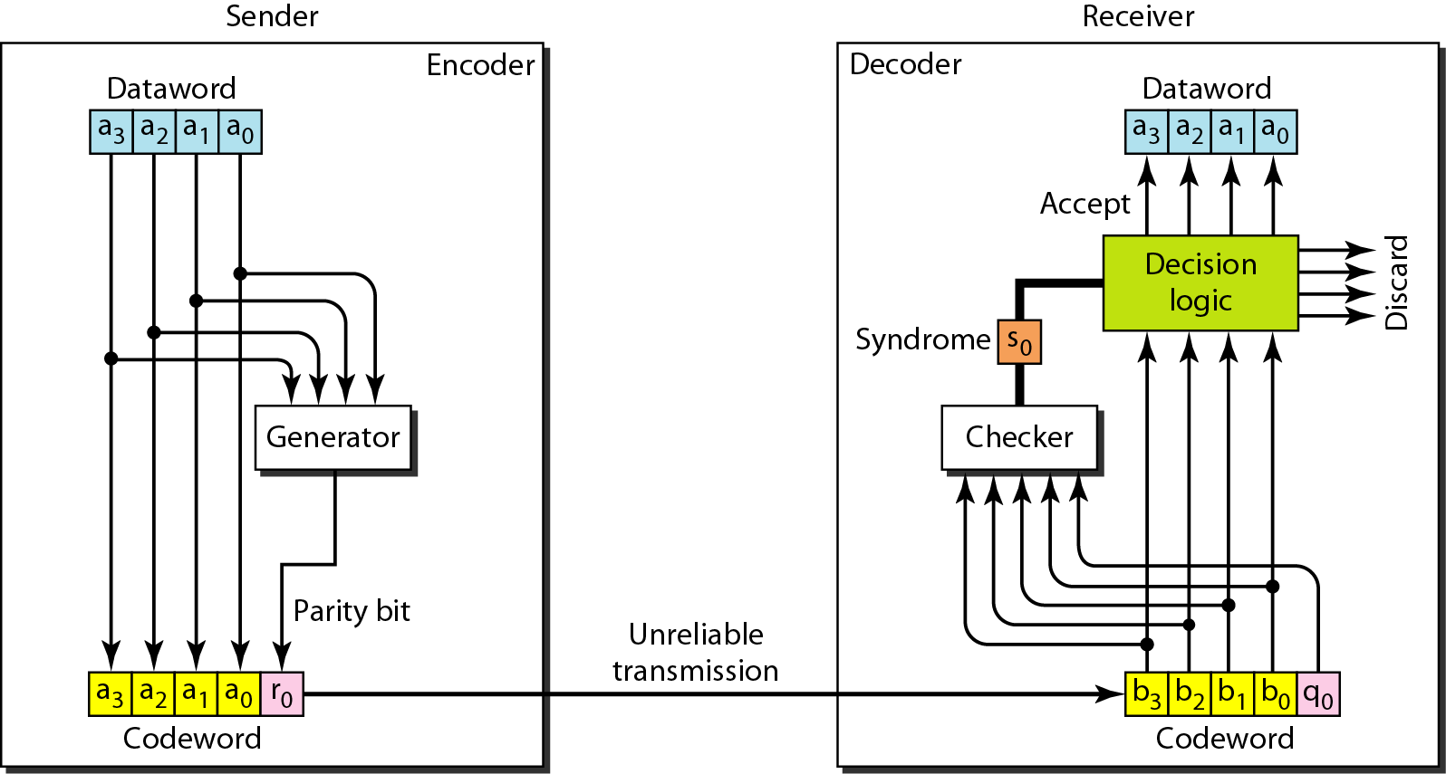
Parity Check Code (Cont.)
Encoder and decoder for simple parity-check code C(5, 4)

Slide 29
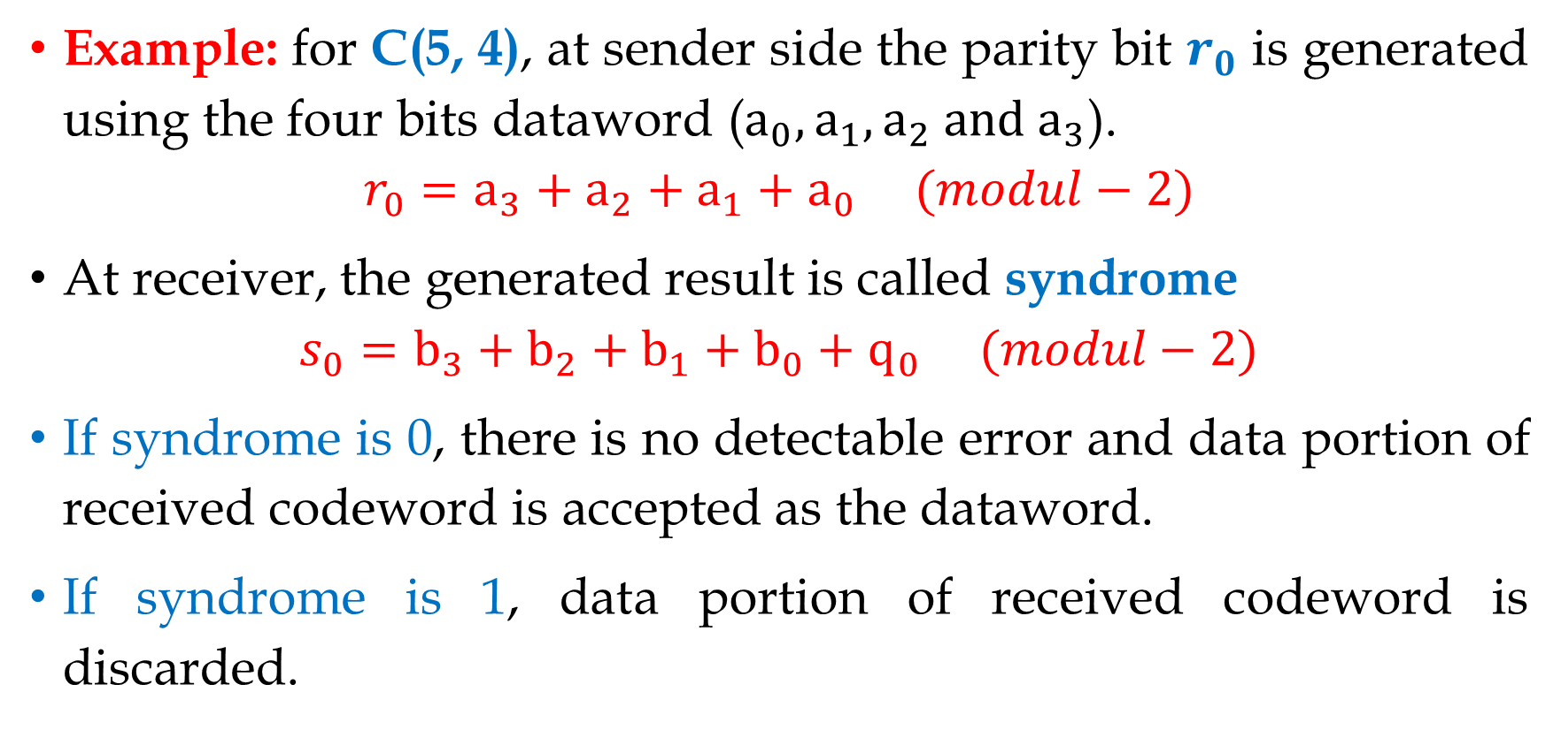
Parity Check Code (Cont.)
Example: for C(5, 4), at sender side the parity bit $r_{0}$ is generated using the four bits dataword ($a_{0},a_{1},a_{2} and a_{3}$).
$$r_{0}=a_{3}+a_{2}+a_{1}+a_{0} (modul−2)$$
At receiver, the generated result is called syndrome
$$s_{0}=b_{3}+b_{2}+b_{1}+b_{0}+q_{0} (modul−2)$$
If syndrome is 0, there is no detectable error and data portion of received codeword is accepted as the dataword.
If syndrome is 1, data portion of received codeword is discarded.

Slide 30
Parity Check Code (Cont.)
Example: Assume the sender sends the dataword 1011. The codeword created from this dataword is 10111, which is sent to the receiver. We examine five cases:
No error occurs; the received codeword is 10111. The syndrome is 0. The dataword 1011 is created.
One single-bit error changes a₁ . The received codeword is 10011. The syndrome is 1. No dataword is created.
One single-bit error changes r₀ . The received codeword is 10110. The syndrome is 1. No dataword is created.

Slide 31
Parity Check Code (Cont.)
An error changes r₀ and a second error changes a₃ . The received codeword is 00110. The syndrome is 0. The dataword 0011 is created at the receiver. Note that here the dataword is wrongly created due to the syndrome value.
Three bits (a₃, a₂, and a₁) are changed by errors. The received codeword is 01011, and the syndrome is 1. Hence, the dataword is not created.
Note: the above example shows that the simple parity check, guaranteed to detect one single error, can also find any odd number of errors.

Slide 32
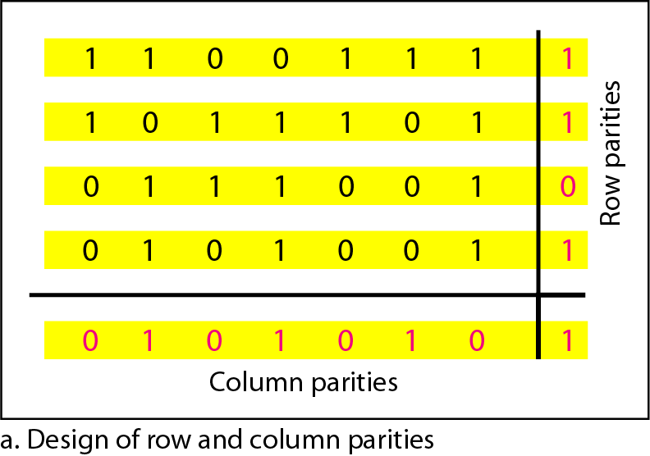
Two-dimensional Parity Check
The datawords are organized in a table (rows and columns).
Example:
Four datawords each of 7-bits are put in separate rows.
For each row and each column, 1 parity-check bit is calculated.

Slide 33
Two-dimensional Parity Check (Cont.)
Example (Cont.):
The whole table is then sent to the receiver, which finds the syndrome for each row and each column.
The two-dimensional parity check can detect up to three errors that occur anywhere in the table. However, errors affecting 4 bits may not be detected.

Slide 34
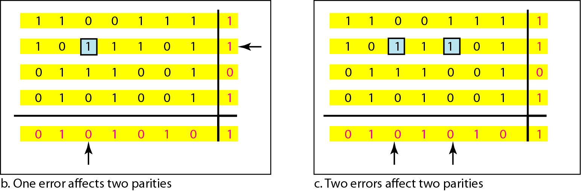

Slide 35
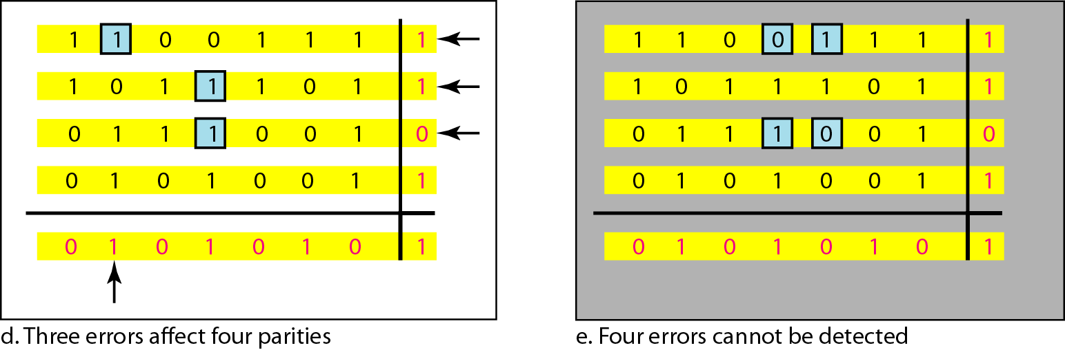

Slide 36
Cyclic Codes
Cyclic codes are special linear block codes with an extra property.
In cyclic code, if a code is cyclically shifted (i.e. rotated), the result is another codeword.
Example: if 1011000 is a codeword, then cyclically left-shifted will become 0110001 is also a codeword.
Cyclic redundancy check (CRC) is a cyclic code used in LANs and WANs for detecting errors.

Slide 37
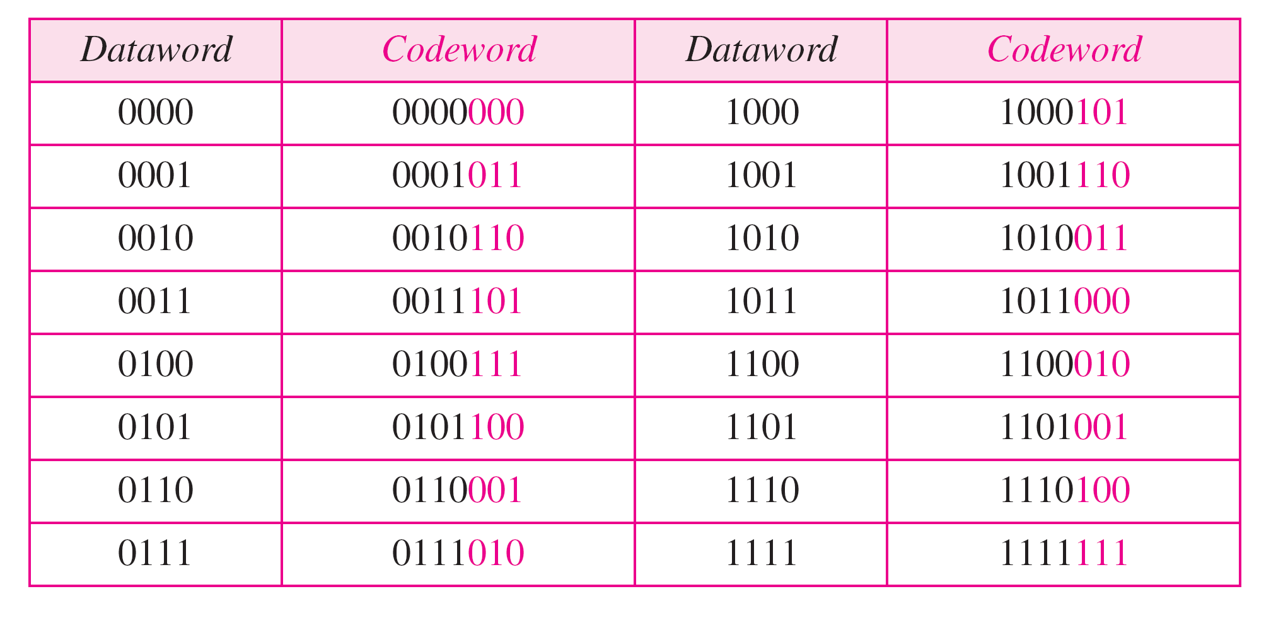
Cyclic Redundancy Check
Both linear and cyclic properties are observed in the table.
A CRC code with C(7, 4)

Slide 38
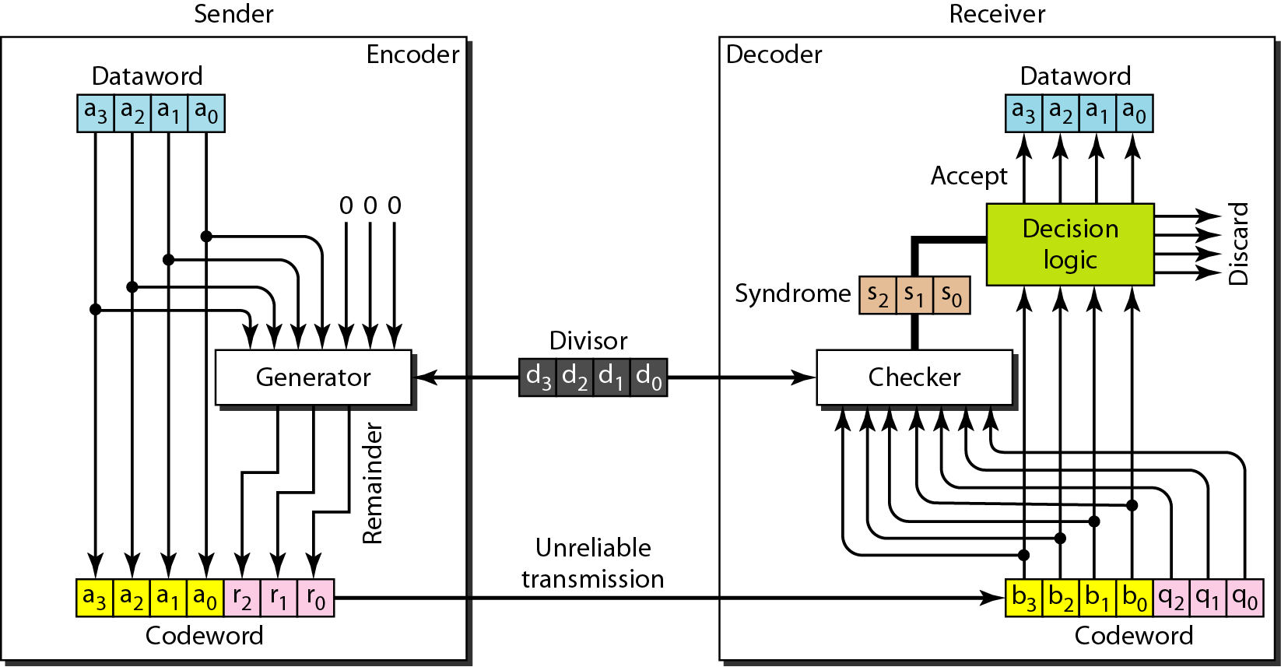
Cyclic Redundancy Check (Cont.)
CRC encoder and decoder

Slide 39
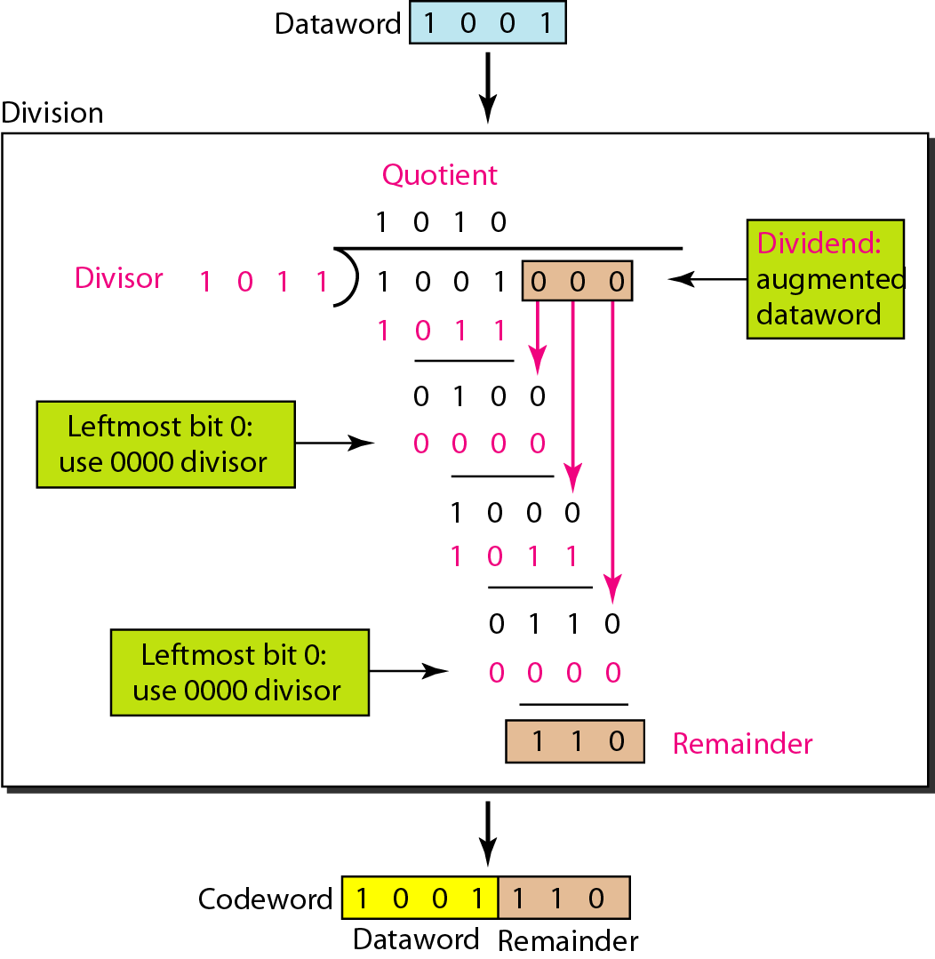
CRC (Cont.)
In example, k = 4, n = 7.
Number of 0s to add (n – k = 3).
Predefined and agreed upon divisor is of size (n – k + 1).
Apply modulu-2 division.
Multiply is AND operator.
Subtract is XOR operator.
Quotient is discarded, while
remainder is appended.

Slide 40
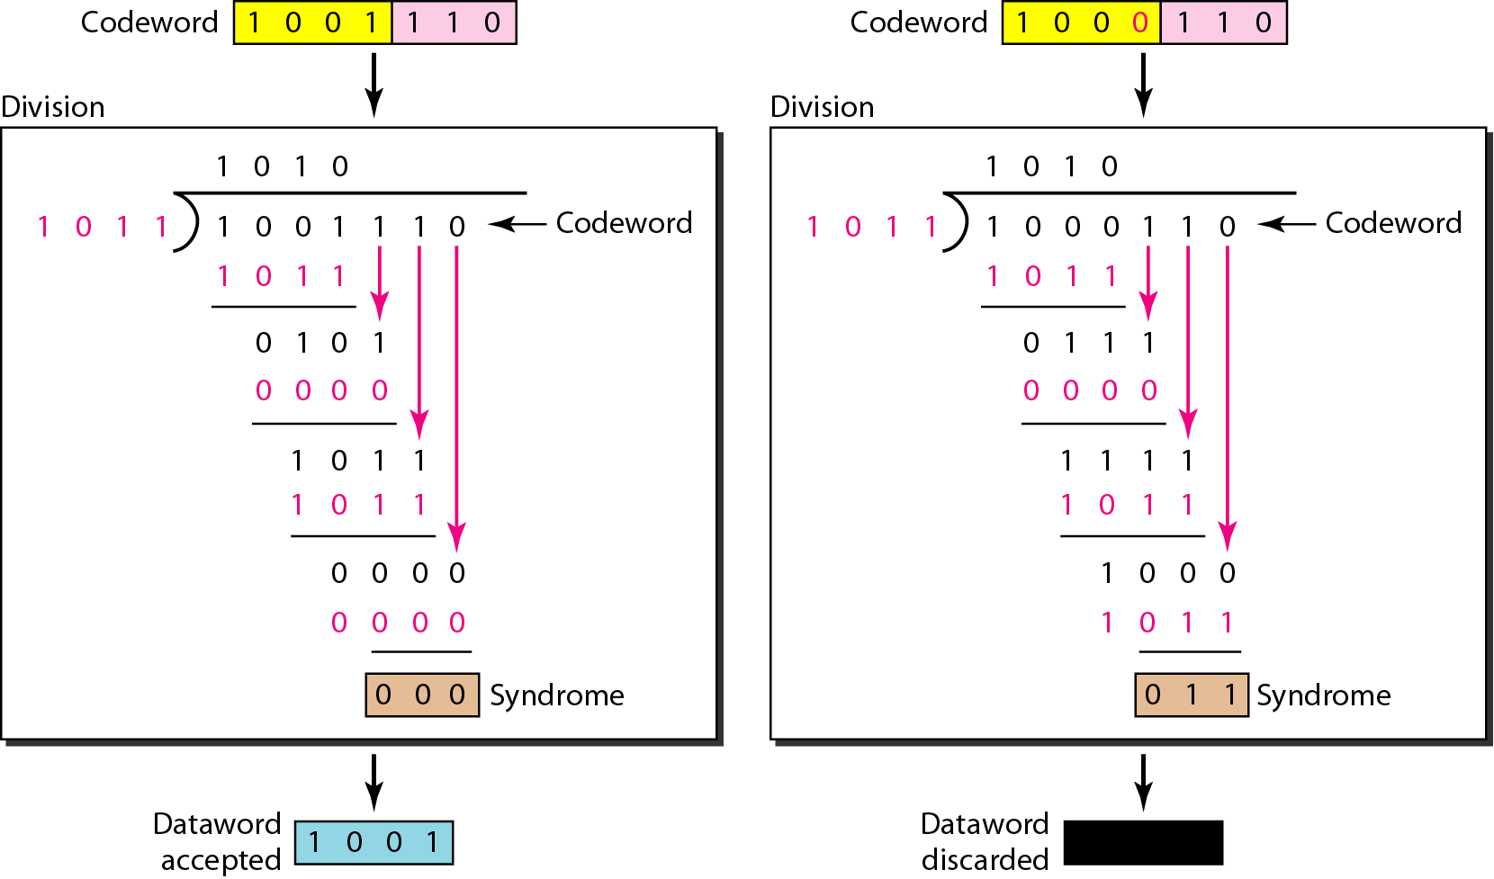
1
The pattern of errors, called the error syndrome.
Division in the CRC decoder for two cases

Slide 41
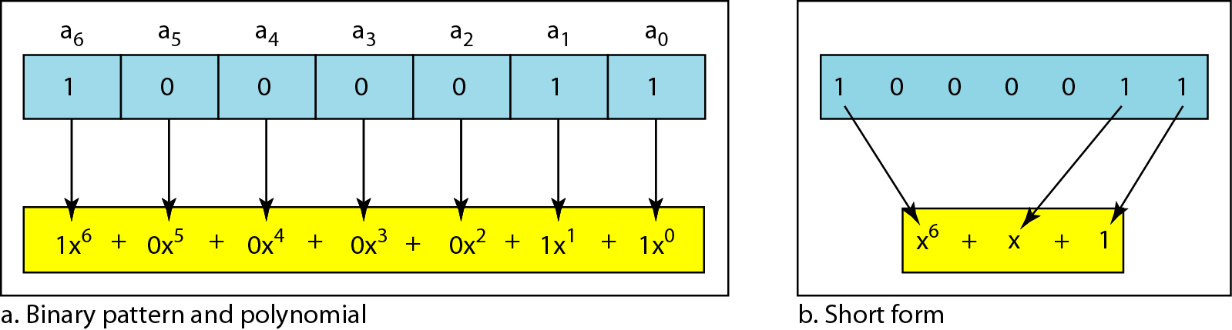

CRC using Polynomials
Polynomial representation
A polynomial can also be like this:
$$x^{23}+x^{3}+1$$

Slide 42
CRC using Polynomials (Cont.)
Things to remember before using polynomials:
Degree of polynomial is the highest power.
Add/subtract polynomial means to combine different terms, while deleting identical terms (only in pairs).
Multiply/divide polynomial means to add and subtract powers, respectively.
Multiply two polynomials is done term by term, followed by simplification.

Slide 43
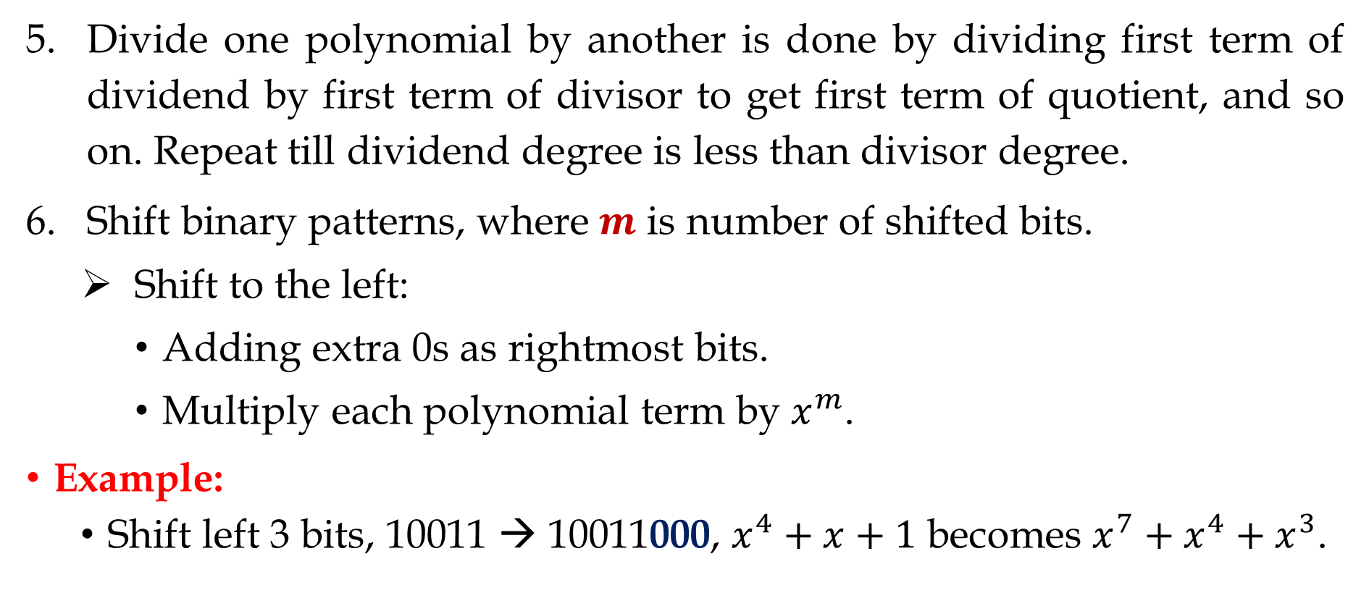
CRC using Polynomials (Cont.)
Divide one polynomial by another is done by dividing first term of dividend by first term of divisor to get first term of quotient, and so on. Repeat till dividend degree is less than divisor degree.
Shift binary patterns, where $m$ is number of shifted bits.
Shift to the left:
Adding extra 0s as rightmost bits.
Multiply each polynomial term by $x^{m}$.
Example:
Shift left 3 bits, 10011 → 10011000, $x^{4}+x+1$ becomes $x^{7}+x^{4}+x^{3}$.

Slide 44
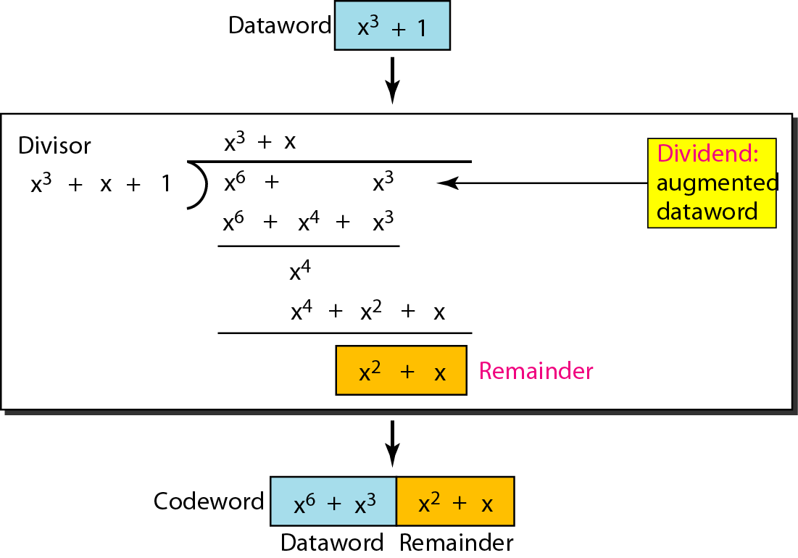
CRC division using polynomials

Slide 45
Thank You!

